Slide 1
net.Console 3.8
User Guide

Slide 2
Content
Start, login, logout
Anatomy of the application
Step by step
Answer a call
Terminate a call
Initiate a call
Attended transfer
Blind transfer
Call parking
Take notes
Advanced features (X900)
Customize the application
General preferences
Keyboard shortcuts
Speed dial’s
Font size
Directory
Voicemail

Slide 3
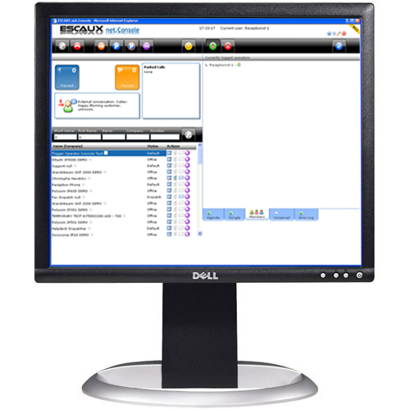
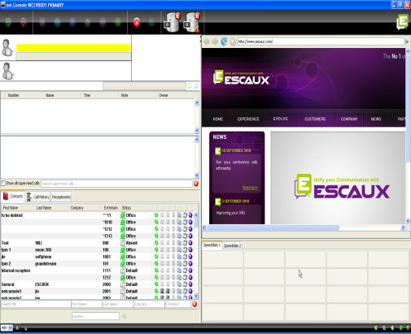
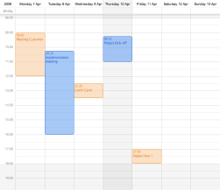
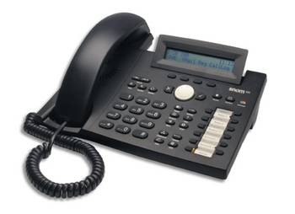
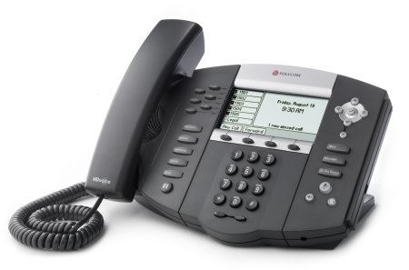
Your desktop
The net.Console‏
SNOM 320
or
Polycom IP 650
Headset (optional)‏

Slide 4
Start, login, logout

Slide 5
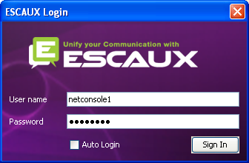
Authenticate and Login
Before you can start accepting calls, you need first to authenticate and then to login.
Authentication window

Slide 6
Login & Logout
Logged out: no general calls or personal calls
Paused: no general calls, only personal calls. This state allows you to terminate your calls before logging out
Logged in: general and personal calls
Press to go to pause
Press to logout
Press to login
Press to go back to pause
Number of receptionists

Slide 7
Login
STEP 1 – Go to Pause
Click on the red button on the left
You are now logged into your personal queue
You are now in pause for the general queue
STEP 2 – Go to Logged In
Click on the red button on the right
You are now logged into your personal queue and the general queue
You are ready to accept calls

Slide 8
Logout
STEP 2 – Go to Logged Out
Click on the green button on the left
You are now logged out of both queues You will not receive incoming calls anymore
STEP 1 – Go to Pause
Click on the green button on the right
You are now in pause for the general queue and still logged into your personal queue
You can finish current calls and still accept personal calls

Slide 9
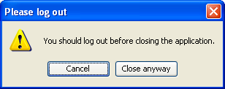
Close application
It is advised to log out before closing the application. If you log out from the “paused” or “logged in” states a warning will display.
If you log out anyway, the application will attempt to remove the phone from the queues but it is advised to log out before closing the application.

Slide 10
Anatomy of the application

Slide 11
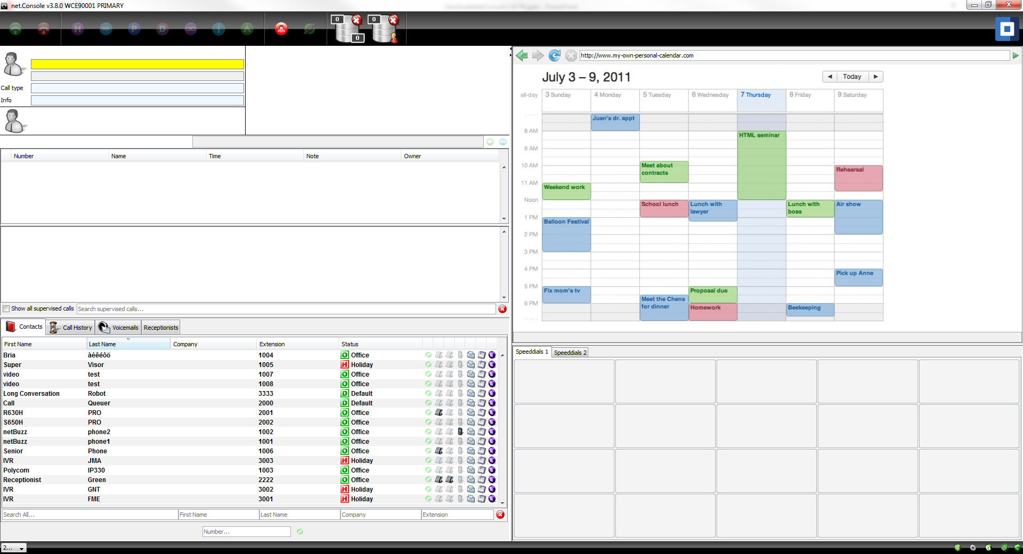
The screen layout – X900
Left pane
Right pane

Slide 12
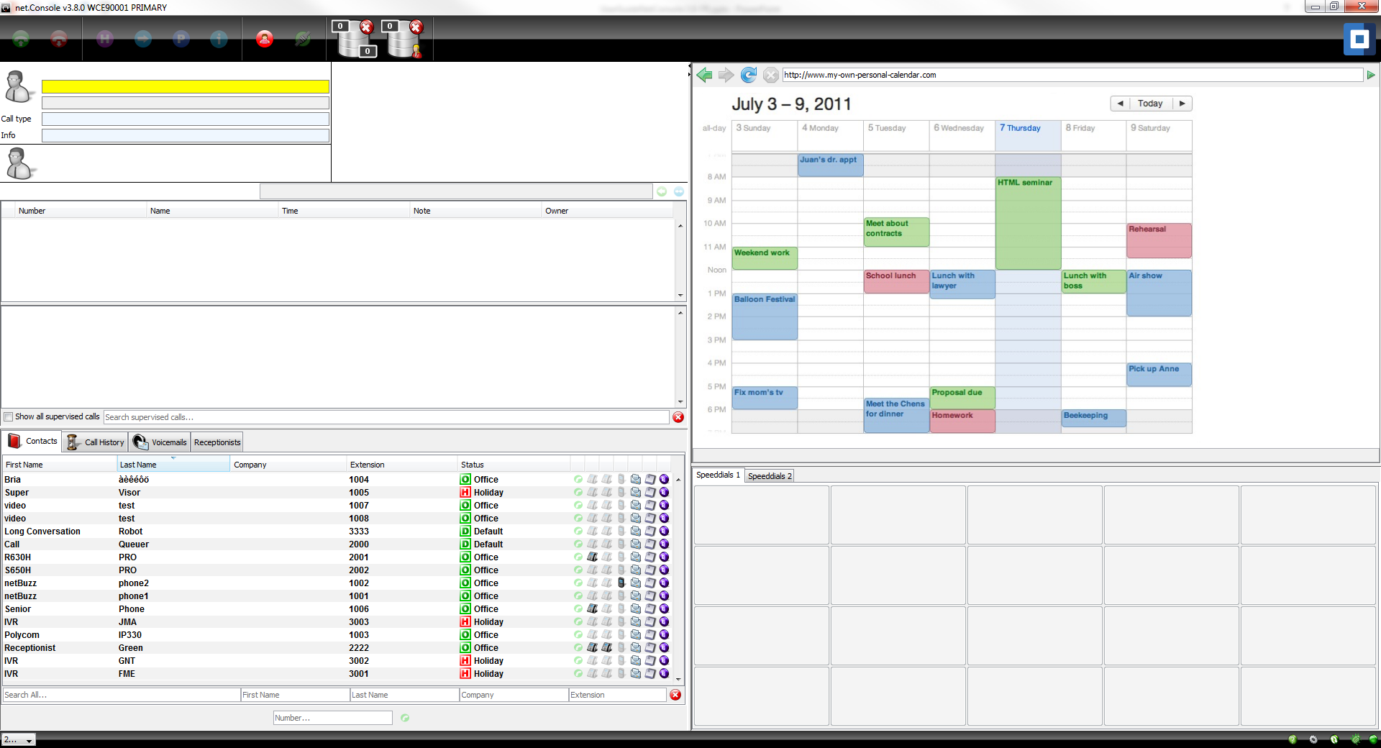
The screen layout – X700
Left pane
Right pane

Slide 13
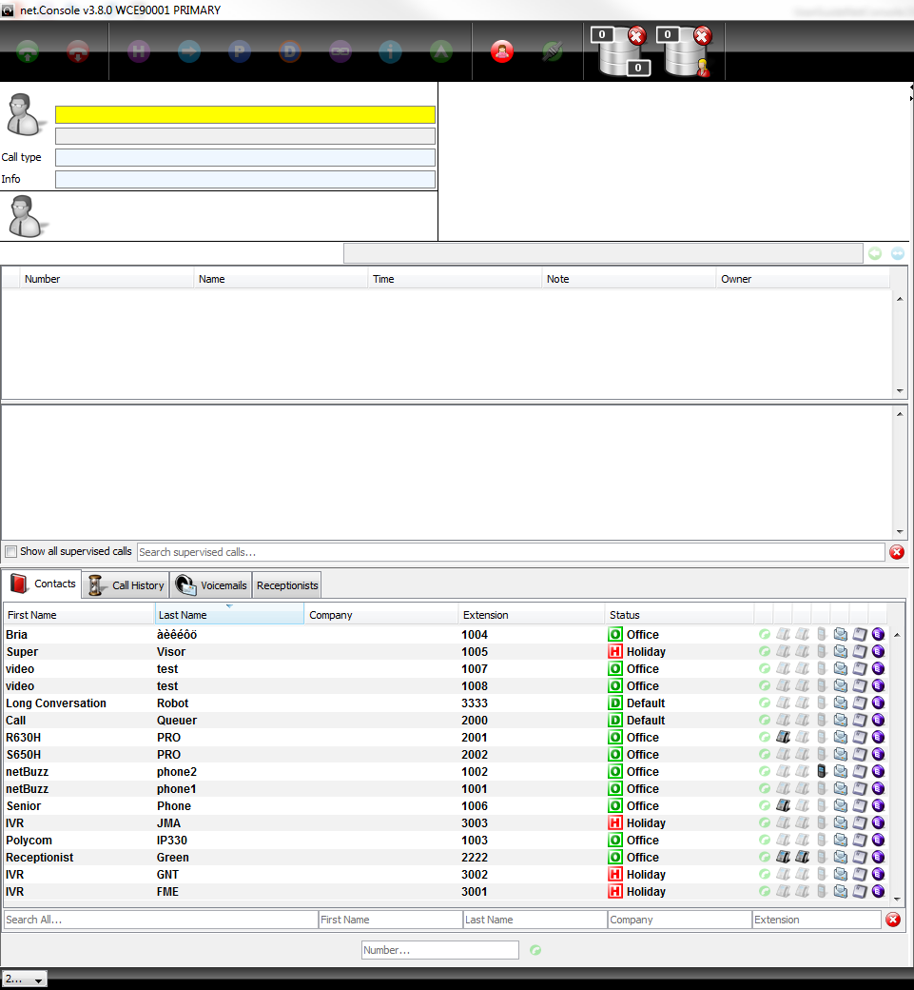
Left pane
Control area
Line Status area
Supervision area
Contacts area

Slide 14
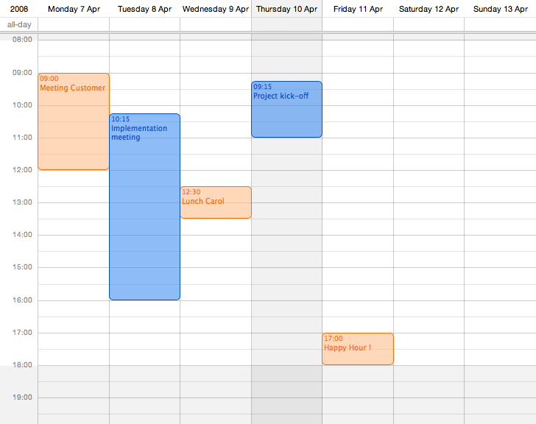
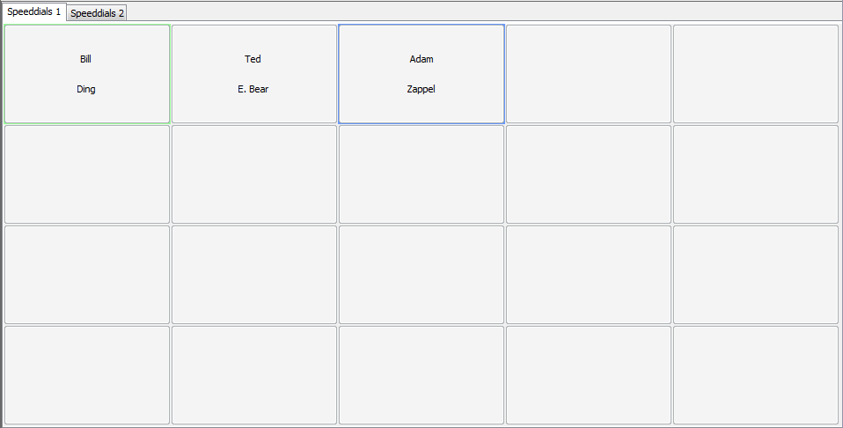
Right pane
Web plugin area
Speeddial area
Mini-toolbar

Slide 15
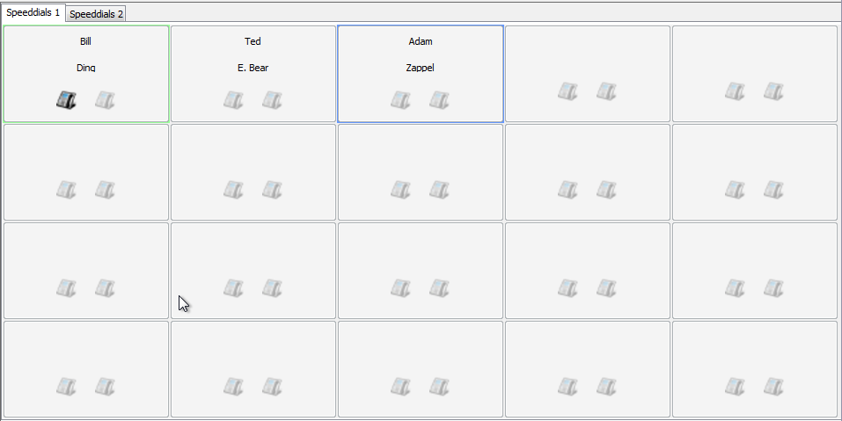
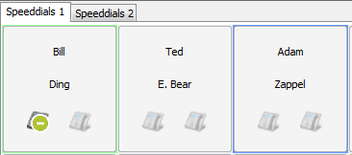
Phone status on speeddials
You can see the phone status on speeddials, like for the Internal Directory, if it is an internal contact
This feature can be enabled in the preferences (see later)
Busy extension

Slide 16
Web component focus
Focus on web component
Focus on main application
Keyboard entries can either be captured by the net.Console or by the web component.
The web component will grab all keyboard shortcuts if it has focus, as indicated by a red border.

Slide 17
Mini-toolbar
Server connection status
Documentation
Sync contacts
Preferences
Send bug report

Slide 18
Control area
The different control keys are contextual
Only the colored keys are functional
Terminate
Transfer
Directed
Park
Call Notes
Camp
pause
Personal
Queue
Accept
Hold
Park
Chain
Logout
General
Queue

Slide 19
Control area
The color of the queue changes with the number of waiting calls
0 calls
1 or 2 calls
3 or 4 calls
5 or more calls

Slide 20
Line status area
Line 1 status
Caller number and name
Last called service
Line 1 history
Caller number and name display can be modified by the system
Line 2 is only used during Attended Transfers
Line 2 status
Called number and name

Slide 21
Supervision area
Supervised calls
Calls in personal queue (and general queue if configured)

Slide 22
Supervision area
Selected call
Update note
Take back or
couple
Type of supervised call
If selected, calls from other operators are shown (supervised calls and calls in personal queues)
Search in supervised and queued calls
Clear search field

Slide 23
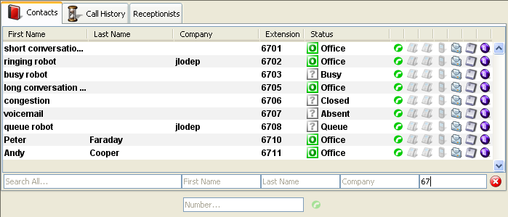
Contacts
Scroll through directory via up/down keys
Double-click line to dial internal extension
Free
Drag & drop or right-click column headers
Not connected
Busy (external)
Busy (internal)
Auto-search when typing
Dial any number
Refine your search
Clear search field

Slide 24
Contacts
Free
Not connected
Intentional Status
Busy (external)
Single-click to send email
Single-click to dial extension
Busy (internal)
Single-click to dial mobile number
Keyboard status
Source

Slide 25
Customize display
Click on column titles to order the contacts *
Drag & drop column header to reorder columns
Right-click on the column header to show or hide specific columns
* Not for intentional status, phone status and keyboard status as it would impact the net.Console reactivity

Slide 26
Call History
Drag & drop or right-click column headers
Call disposition (placed, answered, missed)
Double-click line to dial internal extension
Search call history
Show all or only missed calls
Clear search field

Slide 27
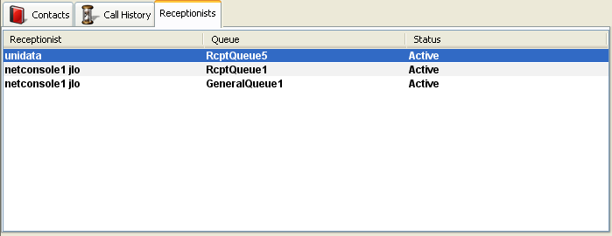
Receptionist
Show status of your colleagues
Drag & drop or right-click column headers
Status field

Slide 28
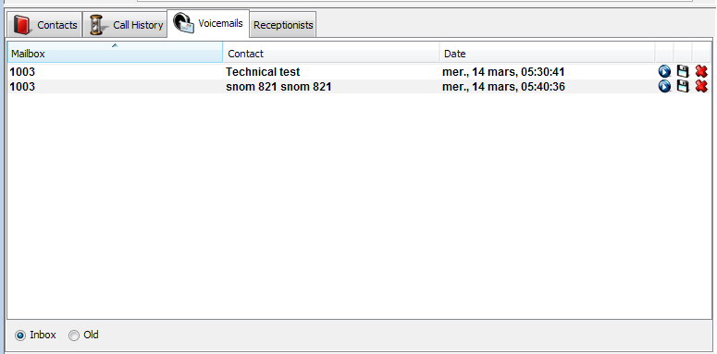
Voicemail
Show voicemail of all your extensions
Drag & drop or right-click column headers
Show new or older messages

Slide 29
Step by step

Slide 30
Answer a call
Call enters general queue
Queue counter increments
Phone rings
Line 1 displays incoming call
“Accept” button lits up
Accept call
Via mouse click on “Accept button”
Or via the “Enter” key
Line 1 status icon changes to conversation
Control keys reflect the conversation state

Slide 31
Terminate a call
“Terminate” button is lit up
Terminate call
Via mouse click on “terminate” button
Or via “F2” key
Line 1 status icon changes to idle
Control keys reflect the idle state
Please note that in the idle state, the “Terminate” button is still lit. This allows you to terminate calls that, for some reason, are remaining on the receptionist phone.

Slide 32
Initiate a call
Several possibilities to initiate a call:
Compose the number on the phone
Double-click directory entry
Mouse-select directory entry and press “Enter”
Single-click dial, phone or mobile icon on directory entry
Compose number in number field and press “Enter”
Select a speed dial

Slide 33
Hold and unhold call
Call is in conversation state
“Hold” button is lit up
Hold call
Via mouse click on “Hold” button
Or via “Enter” key
Line 1 status icon changes to hold
“Hold” button is pressed
Unhold call
Via mouse click on “Hold” button
Or via “Enter” key
Line 1 status icon changes to conversation again

Slide 34
Blind Transfer
Call is in conversation state
Search contact in directory
If the search results in a unique result, the blind transfer is initiated immediately (optional behavior)
If the search return multiple entries, the blind transfer is executed after manually calling an entry
Call “in transfer” shows up in the supervision area
When the destination accepts the call, the line dissapears from the supervision area.
If the destination does not answer:
A manual take back can be performed to terminate the transfer (see later)
An auto-return will occur after a timeout (call enters personal queue)

Slide 35
Blind Transfer to busy number
In most attendant console applications, a blind transfer towards a busy number results in a lost call
With the net.Console, when the destination is busy, the outgoing call is terminated and the original call is placed on hold.
This gives the attendant console agent the opportunity to take back the caller.

Slide 36
Attended Transfer (1)
Call is in conversation state
Place caller on hold
Search contact in directory
If the search results in a unique result, the attendant transfer is initiated immediately (optional behavior)
If the search return multiple entries, the attended transfer is executed after manually calling an entry
Line 2 is in ringing state

Slide 37
Attended Transfer (2)
At this point the control button show the following options:
Confirm Attended Transfer before called person accepts
Direct Park Line 1 on the extension of Line 2
Terminate Line 2
Park Line 1
Camp Line 1 on the extension of Line 2
Terminate Line 2 and unhold Line 1

Slide 38
Attended Transfer (3)
When the called person accepts the call the control buttons show the following options:
After confirming the attended transfer, the call disappears from the net.Console. You can also get back to the caller by terminating Line 2 then Unhold
Confirm Attended Transfer
Terminate Line 2
Chain call (see later)

Slide 39
Attended Transfer (4)
Note that the use of keyboard shortcuts can greatly improve your efficiency.
Example: attended transfer
“Enter” to accept incoming call
“Enter” to place caller on hold
Start typing to search in the directory until you find a unique result
“Enter” to confirm the transfer (after contact accepts the call)
To summarize: Enter, Enter, search, Enter

Slide 40
Take back a call
When you are not in conversation, it is possible to take back a call that sits in the supervision or personal queue list
When taking back a call, any incoming call will be pushed back to the queue
To take back a call, select the line and press the take back button
Take back button

Slide 41
Auto-return of a call
A call in the supervision area will auto-return to the net.Console operator after a configurable time-out (ask your system admin)
This call will enter the personal queue of the operator
< 60%
60% - 80%
> 80%

Slide 42
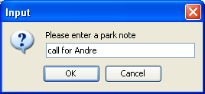
Park a call
To park a call, proceed as follows:
Press the “Park” button or press “F7”
A window pops up allowing you to enter a park note
The call shows up in the supervision area, including the park note
“Park” icon

Slide 43
Couple a call
In order to couple an incoming call with a parked call, proceed as follows:
Accept the incoming call
Select the parked call
Press the “couple” button
Couple button

Slide 44
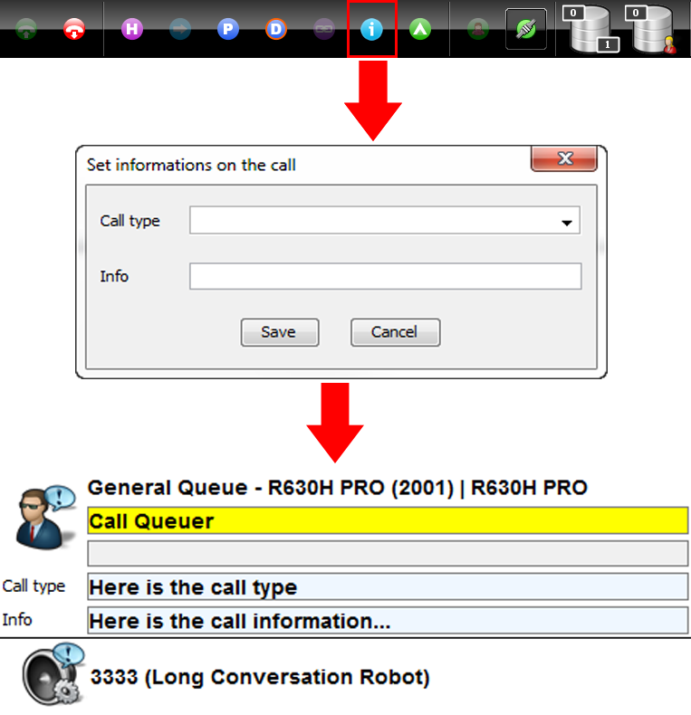
Take notes
Press the “Call Notes” button
Fill in at least one of the two available fields or press the “Cancel” button if you don’t want to add notes anymore
Submit your input by clicking on the “Save” button
Informations regarding the call are now being displayed in the “Line Status” area and are changeable at any time* by pressing again on the “Call Notes” button
*only available for ongoing calls or calls on hold

Slide 45
Advanced features – X900 only

Slide 46
Directed Park
In order to perform a direct parking on the extension of a particular user, proceed as follows:
Press the “Direct Park” button or press “F8”
Dial the user’s extension using the method of choice
The call appears in the supervision area
“Direct Park” icon

Slide 47
Directed Park retrieval
In order to retrieve a direct parked call, the user simply dials *55<ext> from any phone, where <ext> is his personal extension.
As a result the direct parked call dissappears from the supervision area

Slide 48
Transform Attended Transfer into Camp On
In the event the destination is busy during an attended transfer, the attended transfer can be camped on the callee’s extension.
Press the “Camp” button of press “F10”
The call appears in the supervision area

Slide 49
Chaining a call (1)
Chaining a call is similar with Attended Transfer. The only difference is that at the end of the conversation between the caller and the callee, the caller returns back to the operator.
Call chaining offers an operator the possibility to bring the caller in contact with various people without obliging the caller to initiate several calls to the general number.

Slide 50
Chaining a call (2)
To chain a call, follow the exact same procedure as with the Attended Transfer, except when the called person accepts the call, confirm the transfer by pressing on the “chain” button instead of “transfer” button.
After chaining the call, the call appears in the supervision area
When the call terminates, the caller is presented back to the operator’s personal queue.
This offers the possibility to transfer or chain the call to another contact.
Chain button

Slide 51
Customize the application

Slide 52
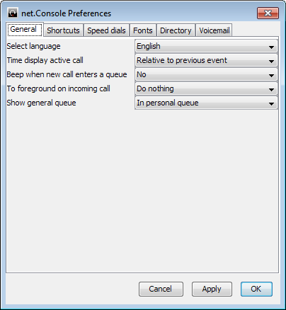
Preferences window
General
Shortcuts
Speed dials
Fonts
Directory
Voicemail

Slide 53
General preferences
Select language of the interface
Time format in Line 1 history
Beep on computer
Window behavior on incoming call
Show calls in the general queue in the supervision area, in the same list as calls from the personal queue.

Slide 54
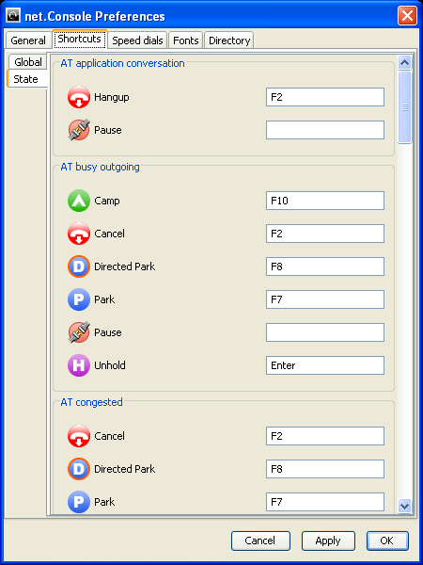
Keyboard shortcuts
State shortcuts
The keyboard shortcut definition is state context specific
A set of pre-defined keyboard shortcuts exists
Global shortcuts
Global shortcuts are state independent and override the state specific shortcuts
Empty by default

Slide 55
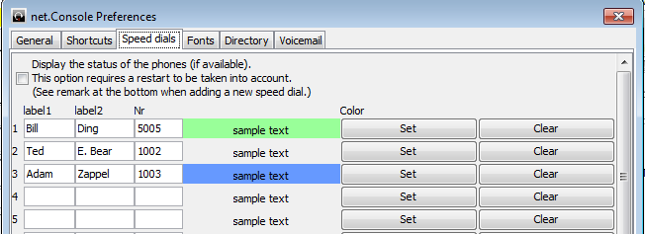
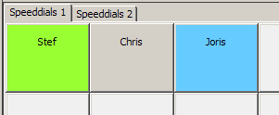
Speeddials
Label 1: typically first name
Label 2: typically last name
Nr: phone number
Color: button color

Slide 56
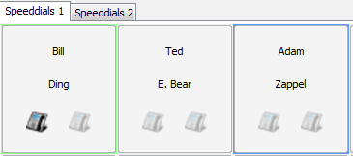
Speeddials with phone status
You can enable phone status on speeddials
Phone status will be updated for internal contacts (like Internal Directory)
This option requires a restart of net.Console

Slide 57
Define font sizes

Slide 58
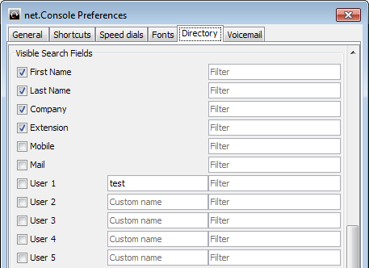
Directory search fields
Select fields included when using “Search All”
Select search fields to display and set default value
Set a custom label for user fields

Slide 59
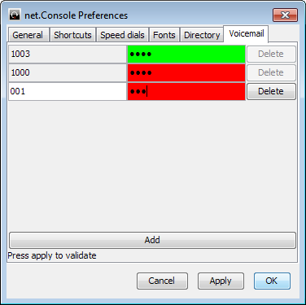
Voicemail options
Choose extensions for which the voicemail box will be monitored
Set the pincode for each extension voicemail box
Red if wrong pincode, green if correct

Slide 60
In case of trouble

Slide 61
Not able to login
If you see this message when you launch net.Console:
Or this one when net.Console is already launched and you try to log into your queues
➔ Check if your phone is connected and try to restart it

Slide 62
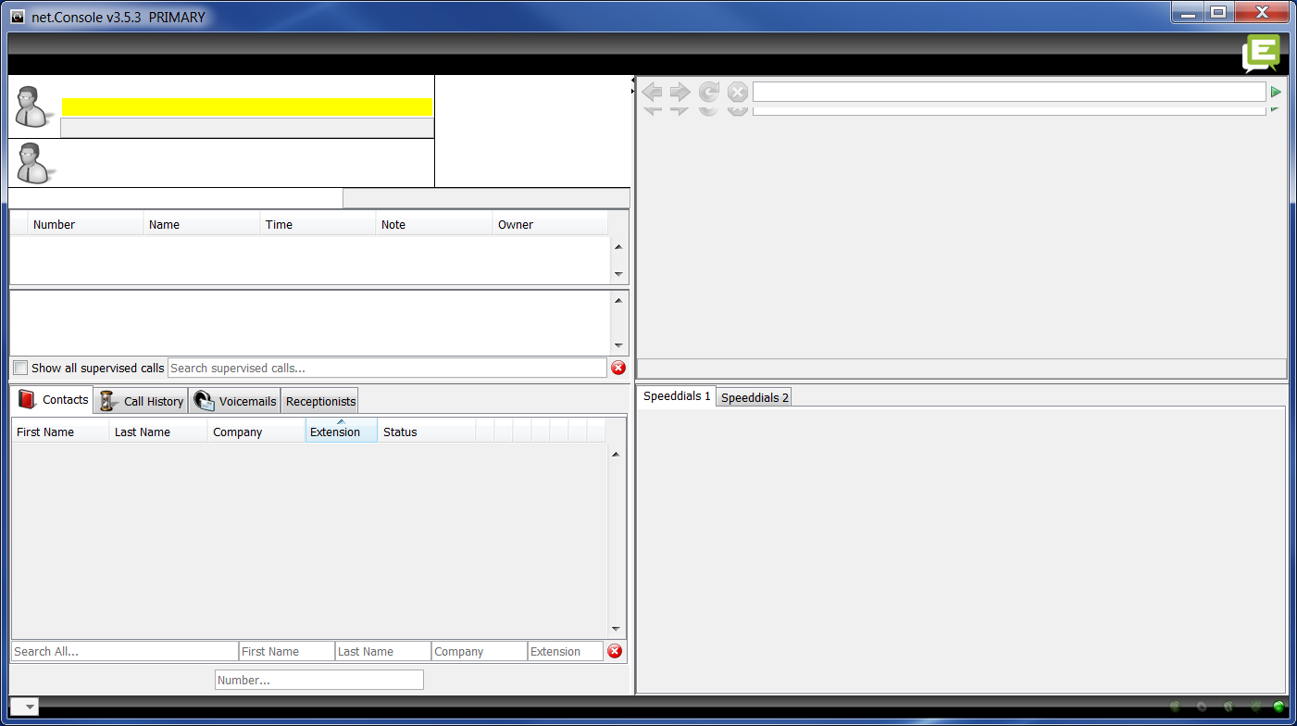
No control button
In case your net.Console is empty and there is no control button, there is probably a network configuration issue on your PC

Slide 63
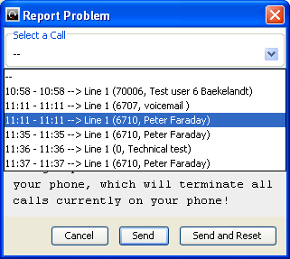
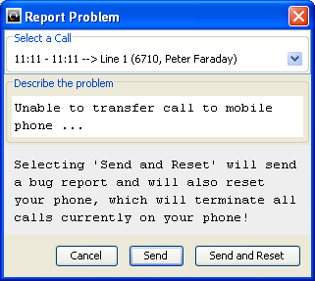
Report a problem
Click to open bug report window
Select the impacted call
Describe the problem

Slide 64
Redundant operation
The ESCAUX net.Console can be deployed as a redundant service running on a primary and secondary server
Each net.Console client is connected both to the primary and secondary server, but is is either listening to the primary server (normal operating mode) or to the secondary server (failover mode)
Normal operating mode,
connected to the primary server
Failover operating mode,
connected to the secondary server

Slide 65
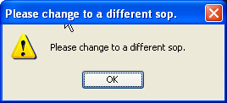
Redundant operation
In the event there is a problem with the primary server, the following actions will take place:
all calls from the gateways will be sent to the secondary server
Each net.Console application receives a warning to switch over to the secondary server. Clicking “OK” will not yet switch the net.Console client over to the secondary server. This offers the possibility to handle (if still possible) the calls still living on the primary server
In the mini-tool, an additional icon appears
Clicking this failover icon performs the actual switch over to the seconday server
Click to switch to secondary server
www.escaux.com

